Slide 1


Epigenetic
Lecture 13
Dr. Rawa Abdul Redha Aziz
Ph.D Antibiotics/ Molecular biology

Slide 2


Slide 3
Epigenetic
Epigenetics is the study of heritable changes in gene expression (active versus inactive genes) that do not involve changes to the underlying DNA sequence, a change in phenotype without a change in genotype, which in turn affects how cells read the genes. Epigenetic change is a regular and natural occurrence but can also be influenced by several factors including age, the environment/lifestyle, and disease state. Epigenetic modifications can manifest as commonly as the manner in which cells terminally differentiate to end up as skin cells, liver cells, brain cells, etc. Or, epigenetic change can have more damaging effects that can result in diseases like cancer. At least three systems including DNA methylation, histone modification and non-coding RNA (ncRNA)-associated gene silencing are currently considered to initiate and sustain epigenetic change. New and ongoing research is continuously uncovering the role of epigenetics in a variety of human disorders and fatal diseases

Slide 4
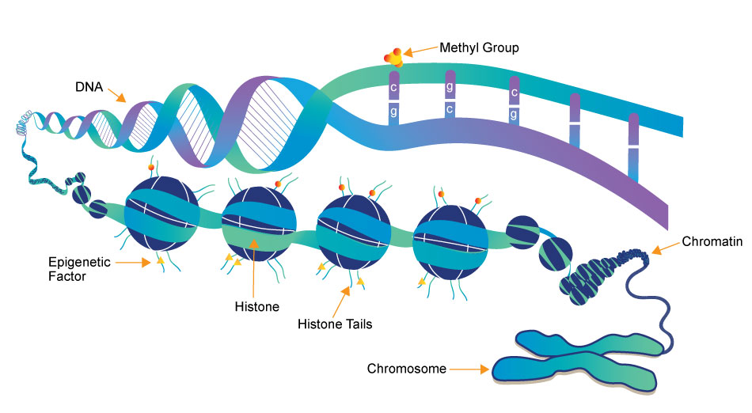

Slide 5
The Evolving Landscape of Epigenetic Research: A Brief History
What began as broad research focused on combining genetics and developmental biology by well-respected scientists including Conrad H. Waddington and Ernst Hadorn during the mid-20th century has evolved into the field we currently refer to as epigenetics? The term epigenetics, which was coined by Waddington in 1942, was derived from the Greek word “epigenesis” which originally described the influence of genetic processes on development. During the 1990s there became a renewed interest in genetic assimilation. This led to elucidation of the molecular basis of Conrad Waddington’s observations in which environmental stress caused genetic assimilation of certain phenotypic characteristics in Drosophila fruit flies. Since then, research efforts have been focused on unraveling the epigenetic mechanisms related to these types of changes

Slide 6
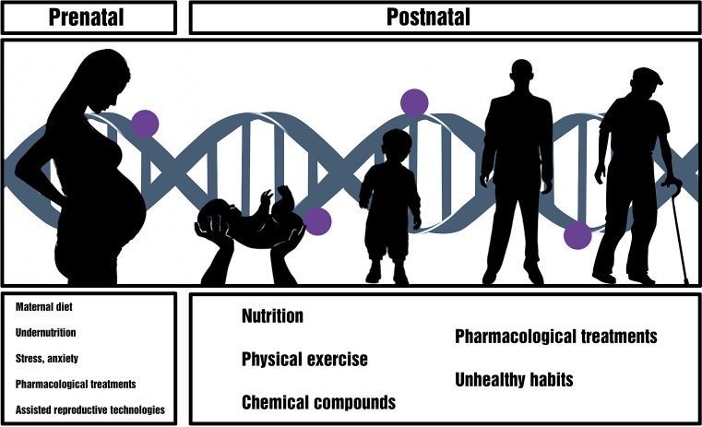
How Lifestyle Can Influence Epigenetic Change from One Generation to the Next
The field of epigenetics is quickly growing and with it the understanding that both the environment and individual lifestyle can also directly interact with the genome to influence epigenetic change

Slide 7

Research has also shown that mother’s exposure to pollution could impact her child’s asthma susceptibility and her intake of vitamin D could change DNA methylation that influences placenta functioning.

Slide 8
How Lifestyle Can Affect Individual Epigenetics and Health
Although our epigenetic marks are more stable during adulthood, they are still thought to be dynamic and modifiable by lifestyle choices and environmental influence. It is becoming more apparent that epigenetic effects occur not just in the womb, but over the full course of a human life span, and that epigenetic changes could be reversed. There are numerous examples of epigenetics that show how different lifestyle choices and environmental exposures can alter marks on top of DNA and play a role in determining health outcomes.

Slide 9

Researchers have found that a ketogenic diet – consuming high amounts of fat, adequate protein, and low carbohydrates – increases an epigenetic agent naturally produced by the body.

Slide 10
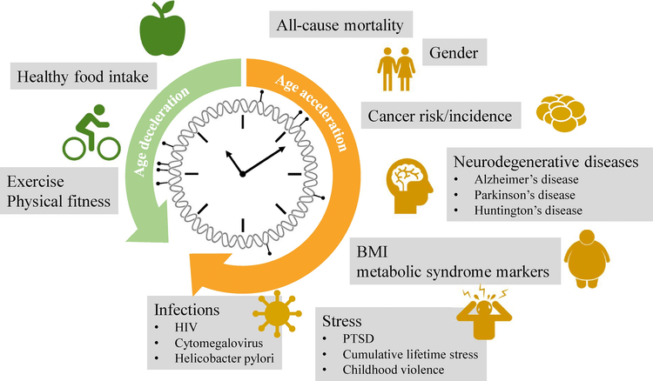

Slide 11


